Slide 1
Modeling the Digital Map based on RFC8345: Sharing Experience
IETF 118, Prague, 5 Dec 2023
olga.havel@huawei.com

Slide 2
Community (Authors and Contributors)
Generic Digital Map drafts:
IGP Digital Map drafts:
draft-havel-opsawg-digital-map
Oscar Gonzalez de Dios oscar.gonzalezdedios@telefonica.com
Ahmed Elhassany Ahmed.Elhassany@swisscom.com
Thomas Graf thomas.graf@swisscom.com
Mohamed Boucadair mohamed.boucadair@orange.com
Olga Havel olga.havel@huawei.com
Benoit Claise benoit.claise@huawei.com
Nigel Davis ndavis@ciena.com
draft-ogondio-opsawg-isis-topology
Oscar Gonzalez de Dios oscar.gonzalezdedios@telefonica.com
Samier Barguil Giraldo samier.barguil_giraldo@nokia.com
Victor Lopez victor.lopez@Nokia.com
Daniele Ceccarelli dceccare@cisco.com
Benoit Claise benoit.claise@huawei.com
Olga Havel olga.havel@huawei.com
Pablo Pavon pablo.pavon@upct.es
draft-davis-opsawg-some-refinements-to-rfc8345
Nigel Davis ndavis@ciena.com
Olga Havel olga.havel@huawei.com
Benoit Claise benoit.claise@huawei.com
draft-ogondio-opsawg-ospf-topology
Oscar Gonzalez de Dios oscar.gonzalezdedios@telefonica.com
Samier Barguil Giraldo samier.barguil_giraldo@nokia.com
Victor Lopez victor.lopez@Nokia.com

Slide 3
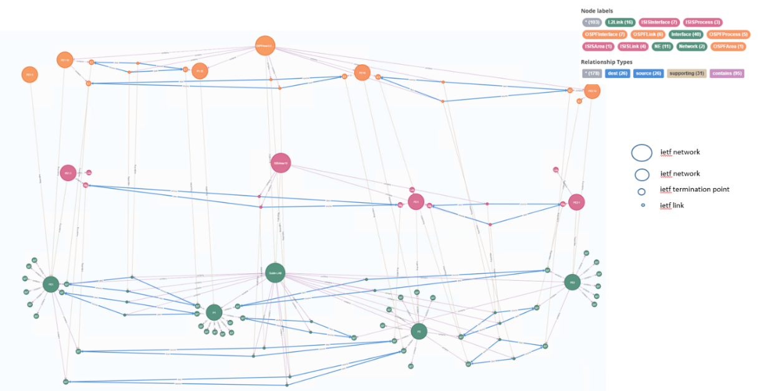
Objectives
Can the central RFC 8345 YANG module be a good basis to model a Digital Map?
How the different topology related IETF YANG modules fit (or not) together?
Modelling of digital map entities, relationships, and rules, how to build aggregated entities and relationships from device to network views
Does the base model support key requirements that emerge for a specific layer?
Modelling multiple underlay/overlay layers from physical to customer service layer. To what extent it is easy to augment the base model to support new technologies?
Can the base model be augmented for any new layer and technologies?

Slide 4
Core Digital Map Use Cases and Requirements collected from Operators so far
Requirements:
Basic model with Network, Node, Link, Interface, Layers
Layered from physical to customer service (intent)
Open and programmable (read/write for what-if for DM)
Standard based Digital Map model and API
Cross-domain
Semantics for layered network topologies
Relationships
Extensible with metadata
Pluggable for specific functional modules
inventory, KPIs, ..
Note: not everything will be in YANG
Optimized for graph traversal
Use Cases:
Network Inventory Queries
Service Placement Feasibility Checks
Service->Subservice->Resource
Resource->Subservice->Service
Intent / Service Assurance
Service E2E and Per-Link KPIs on the Digital Map (delay, jitter and loss)
Capacity Planning
Network Design
Simulations
Closed Loop
Different users may use different layers and have different requirements

Slide 5
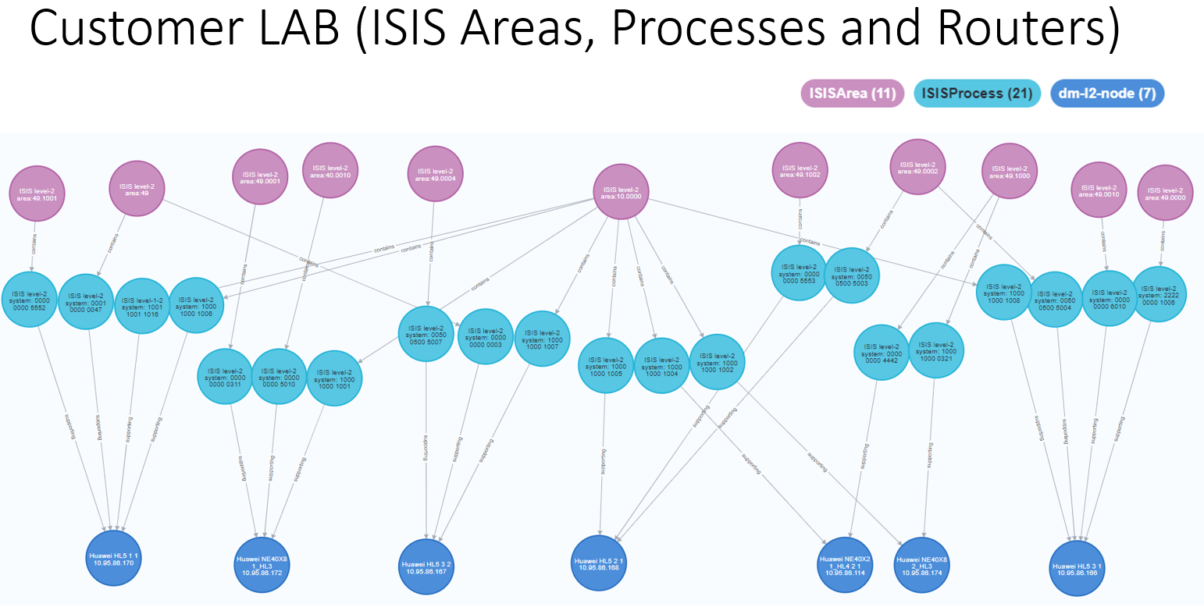
What we implemented and evaluated
Technologies implemented in the PoC, 4 LABs, 2 operator LABs:
Implemented with RFC 8345 (with and without limitations + feedback)
Common Network Topology (aligned with RFC8345)
Layer 2 Network Topology (aligned with RFC8944)
Layer 3 Network Topology (aligned with RFC8346)
OSPF routing (aligned with draft-ogondio-opsawg-ospf-topology-01)
IS-IS routing (aligned with draft-ogondio-opsawg-isis-topology-01)
Implemented with RFC 8345 (with and without limitations), custom augmentations for new network types and network, node, tp and link properties, to align with any standards in the future PoC versions:
BGP routing
MPLS LDP and MPLS TE Tunnels
SRv6 Tunnels
L3VPN service
IETF:
Network Topology
IETF:
Digital Map
NMRG:
Digital Twin

Slide 6
RFC 8345 Limitations for Digital Map Modelling?
Proposed solutions in:
draft-davis-opsawg-some-refinements-to-rfc8345
Bidirectional links
Multi-point connectivity (hub and spoke, full mesh, complex)
Links between domains/networks
Networks part of other networks
Nodes, TPs and Links in multiple networks
We need additional supporting relationships (TP->Node, Node->Network)
Relationship Properties
Termination Point Roles
Layers / Sublayers
Tunnels and Paths. Further analysis for RFC8345 versus RFC8795
Supporting or underlay. Further analysis for RFC8345 versus RFC8795
Implemented the IS-IS and OSPF using the drafts:
draft-ogondio-opsawg-isis-topology
draft-ogondio-opsawg-ospf-topology
Identified the limitations
YOUR FEEDBACK?

Slide 7
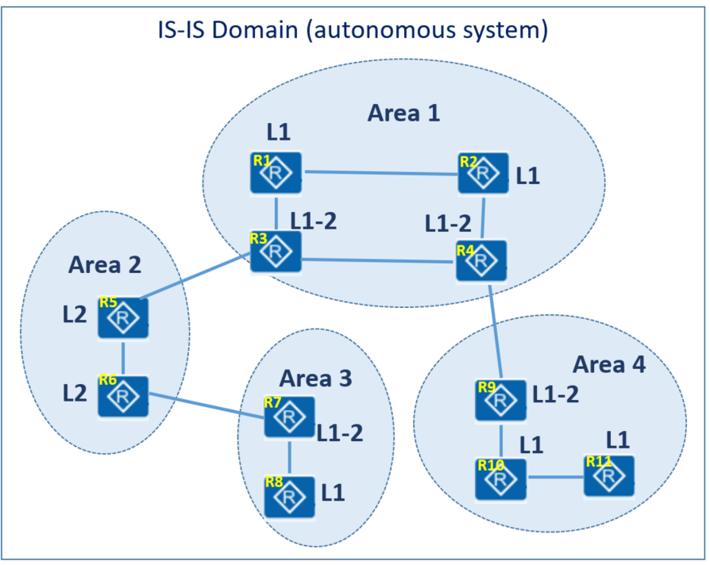
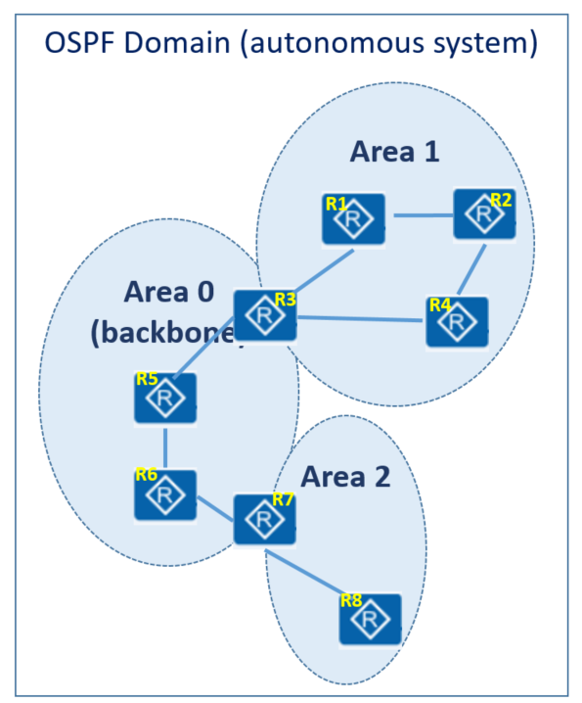
How to model IS-IS and OSPF the right way?
RFC 8345 does not model links between different networks
Why is it a problem for IS-IS Digital Map?
we cannot model IS-IS areas as topological entities without extending RFC 8345
What about OSPF?
This is NOT the problem for OSPF as the links belong to one area only, nodes can belong to multiple areas
RFC 8345 does not allow networks to be part of other networks
Why is it a problem for IS-IS Digital Map?
we cannot model AS with multiple IS-IS areas through containment or part-of relationship
What about OSPF?
This is a problem for OSPF Digital Map as well (AS with multiple OSPF Areas)
RFC 8345 does not allow nodes to belong to multiple networks
Why is it a problem for IS-IS Digital Map?
if a routing process and interfaces can belong to multiple area, we need to enable the same nodes and interfaces to be parts of multiple networks.
What about OSPF?
This is a problem for OSPF Digital Map as well, OSPF nodes can belong to multiple areas, although interfaces must belong to 1 area only

Slide 8
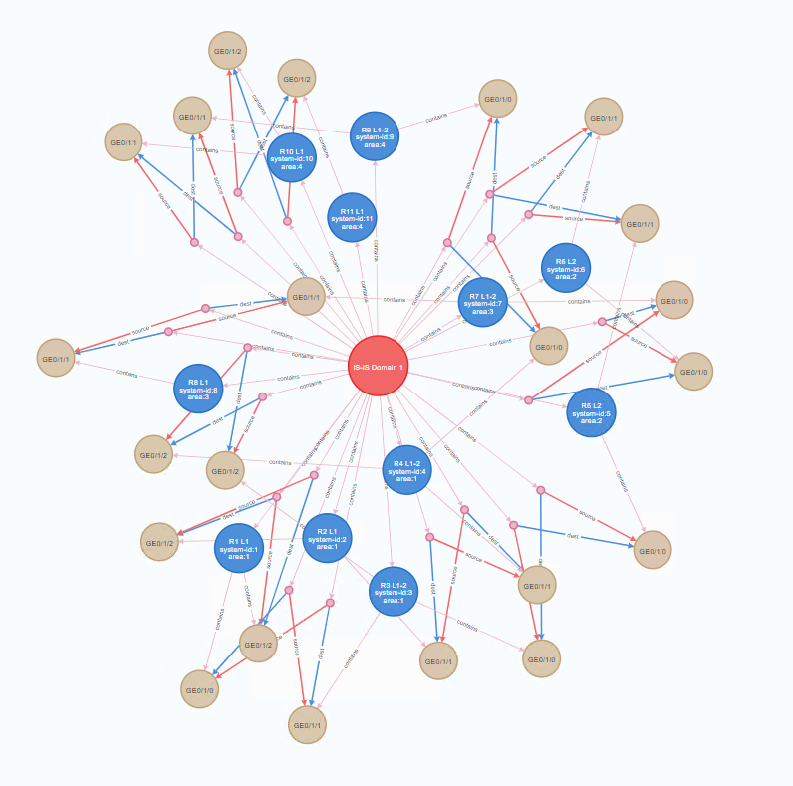
Modelling IS-IS Areas (with RFC 8345 limitations)
IS-IS Domain is network, IS-IS Areas info in attributes
IS-IS processes grouped in the IS-IS area via the specific IS-IS attribute
applications would need to understand the meaning of the specific IS-IS attributes in order to understand IS-IS topology
does not represent the topology of the IS-IS Domain via entities - relationships

Slide 9
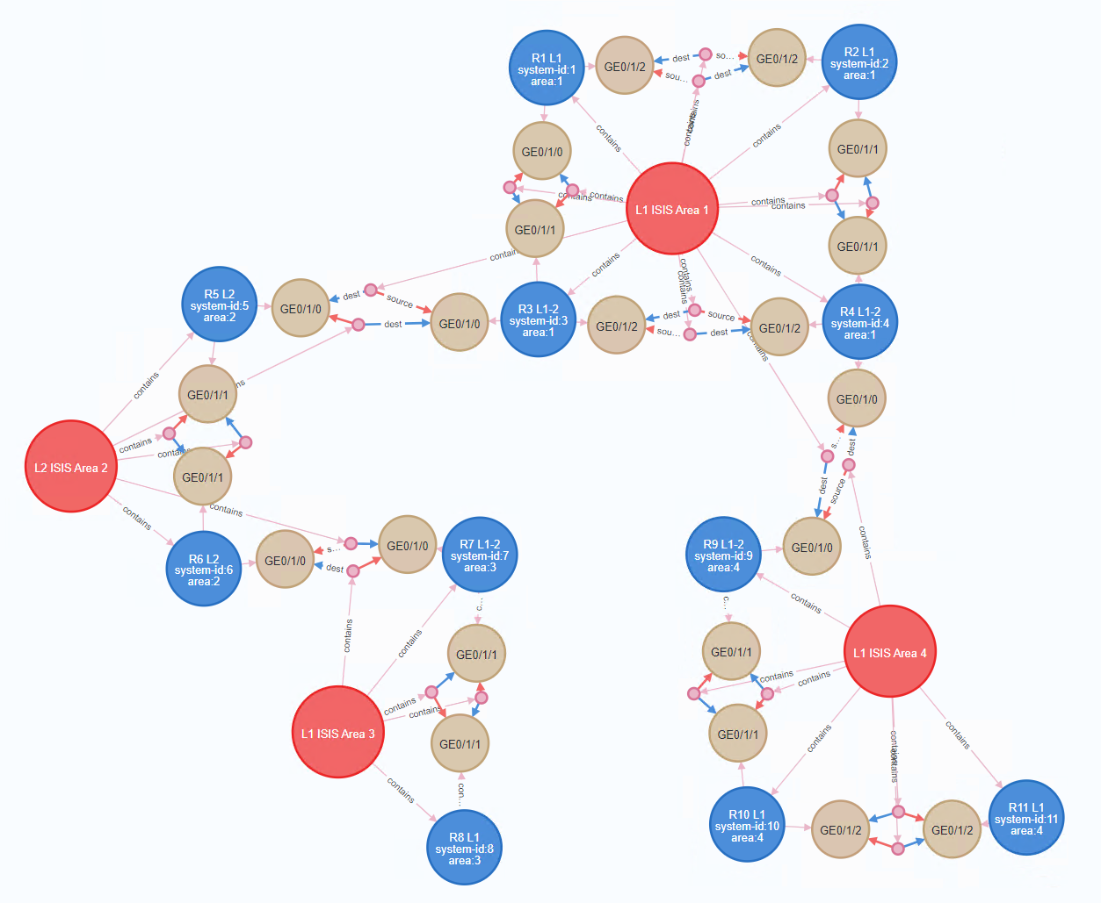
Modelling IS-IS Areas (without RFC8345 limitations)
IS-IS Area is Network
aligned with the real topology
allows drill down from the AS->Areas->Processes
scale
aligned with the IS-IS topology model and the IS-IS network view in the manuals and training material, IS-IS area entity exists in the model

Slide 10
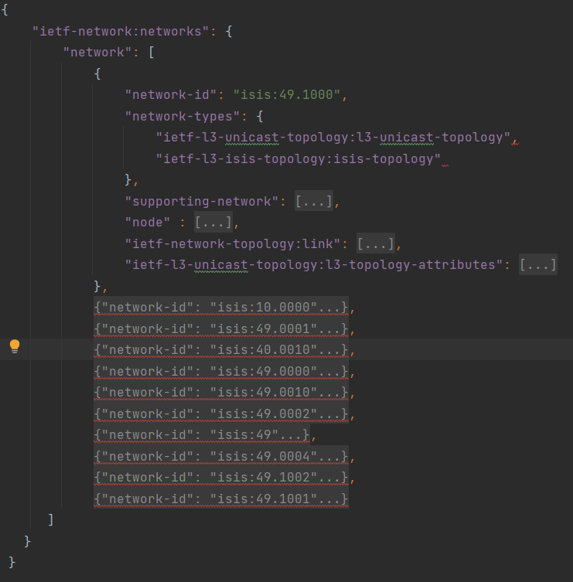
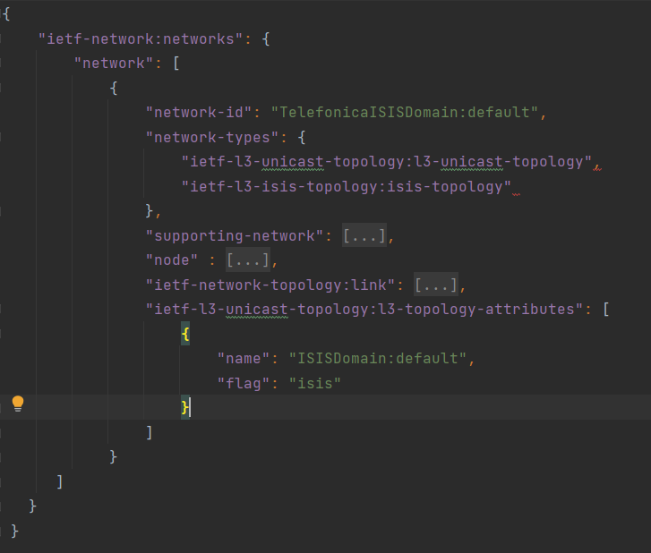
IS-IS Topology requests – from a Customer LAB
digital map modelling:
draft-ogondio-opsawg-isis-topology
Option 1: No IS-IS Areas
with RFC8345 limitations
Option 2: With IS-IS Areas
without RFC8345 limitations
Controller
RFC9130 ietf-isis
openconfig-isis
We did it in our PoC
An operator LAB
We did it in our PoC
An operator LAB
Device
Device
Device
Router

Slide 11
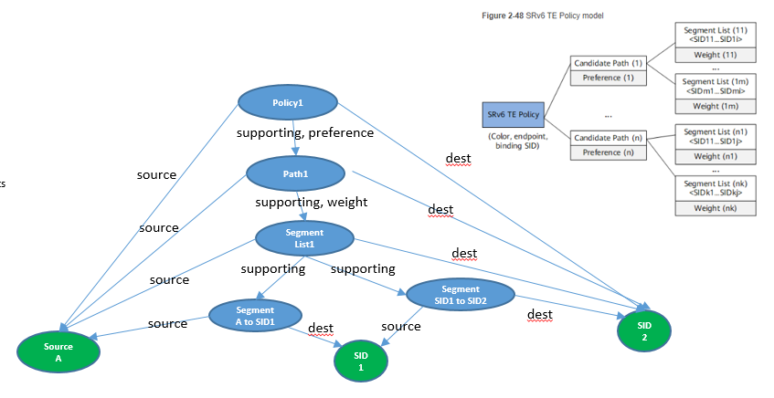
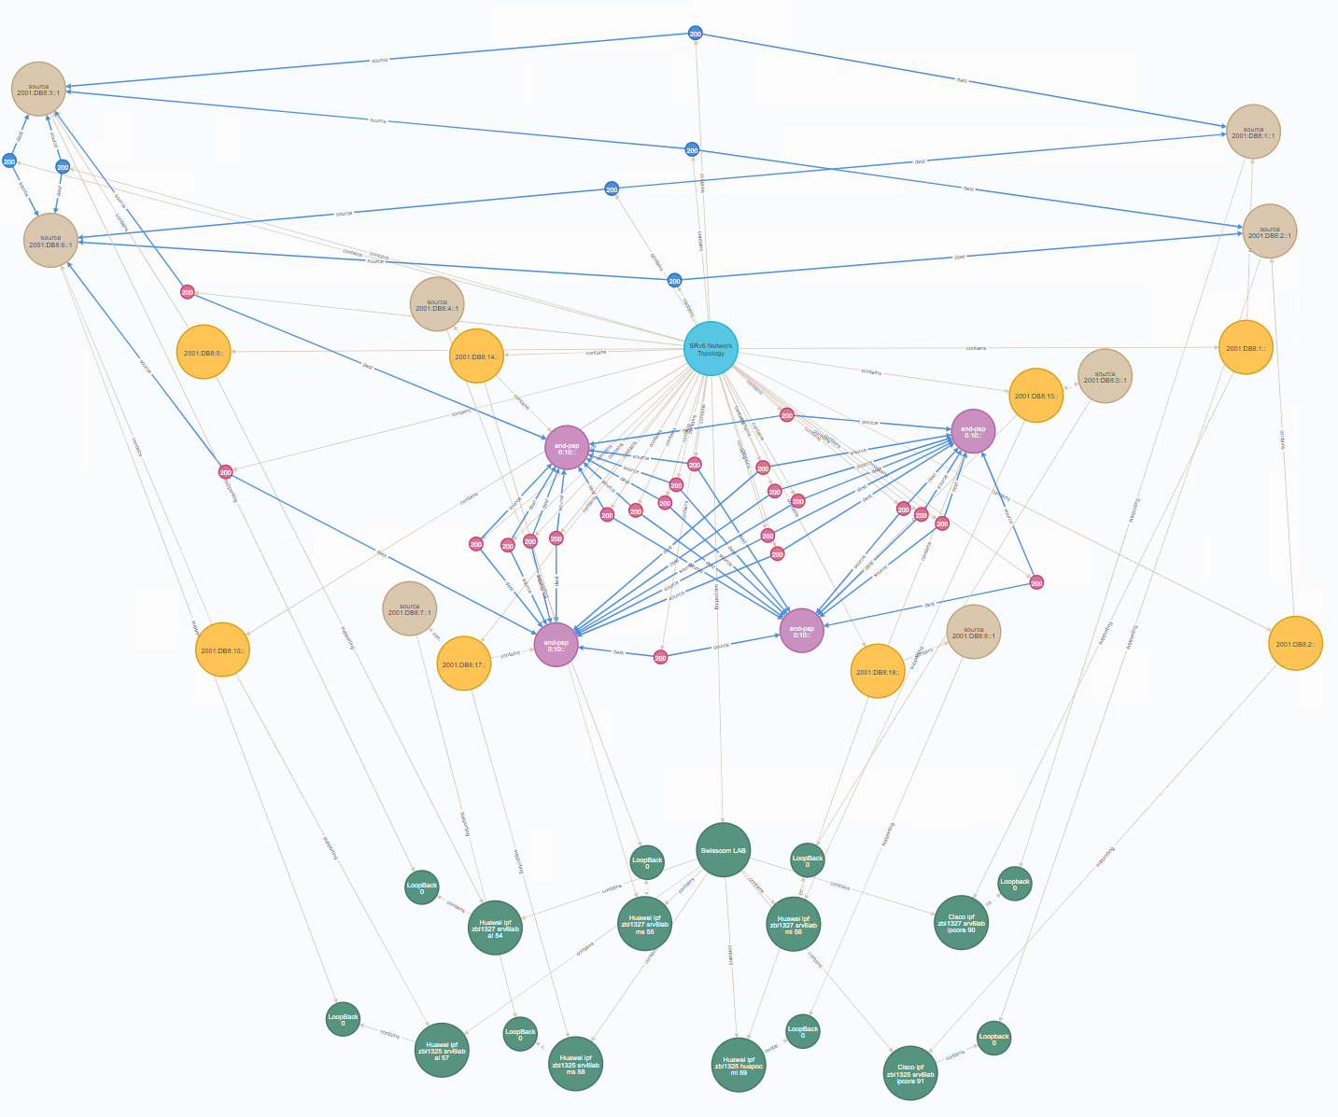
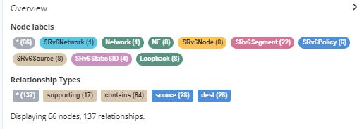
We started working on SRv6 Topology
We did it in our PoC
An operator LAB
We identified the 2 layers:
SRv6 segment / SRv6 network topology: SRv6 Network(s), SRv6 locators as nodes , source, static and dynamic SIDs as tps, segments and segment lists as links
SRv6 tunnel topology: policies / tunnels on top of segment lists, sharing
What next?
review initial modelling in the PoC with customers
do we need multiple networks? Option 1 versus Option 2
discuss and finalize relations to services, BGP and IS-IS
do we want to distinguish between static and dynamic SIDs (2 options)
do we need to add attributes to the RFC8345 relations (weights)
Research RFC 8345 versus RFC8795 approach

Slide 12
What’s Next?
Do SRv6 topology the right way from the beginning!! Dependency with routing – circular dependency?
How the different IGP domains topologies are linked together and with BGP
Continue our Evaluation and PoC
Evaluate other IETF technology-specific augmentation, one by one
More operators and LABs
How to fulfil all the digital map requirements
How to connect to the external world - other YANG modules, not only YANG
How to remove the identified limitations
Subset of RFC8345 improvements in draft-davis-opsawg-some-refinements-to-rfc8345
More drafts for other improvements to come
Define guidelines for how to augment for new technologies / layers
Report observations on regular basis to the IETF

Slide 13
Comments ? Questions?

Slide 14
Help Slides

Slide 15
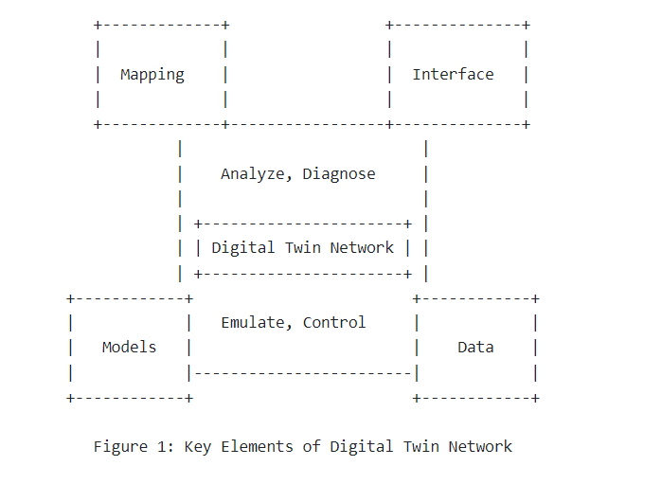
Why Digital Map?
IETF:
Network Topology
IETF:
Digital Map
NMRG:
Digital Twin
Digital Twin [draft-irtf-nmrg-network-digital-twin-arch]
collects the topology data, KPI data, alarm data, incident data
stores configuration data, traffic engineered data, planned data (what if), simulation and emulation data and behaviours
has information about actions and behaviours at different layer that can be device specific, network-wide or per customer services
How to correlate all models and data in the Digital Twin?
via topological entities at different layers (from physical to customer service)
Hence the Digital Map is the basis and prerequisite for the Digital Twin
It provides a basic model and a virtual instance of the topological information in the network
correlates all Digital Twin data to topological entities at different layers in the layered twin network
Digital Map

Slide 16
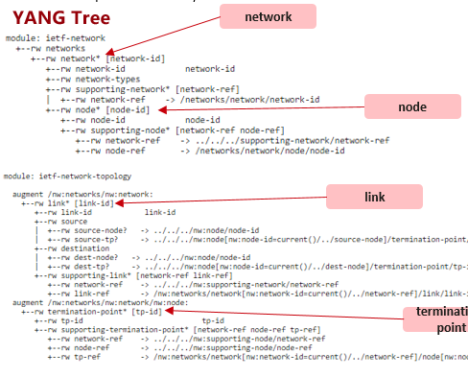
What is Digital Map?
Digital Map provides the core multi-layer topology model of the digital twin that defines:
the core topological entities
their role in the network
core properties that identify entities at different layers
relationships between the entities, both inside each layer and between the layers
Digital Map model is a basic topological model that must link to other functional parts of the digital twin and connects them all:
configuration, maintenance, assurance (KPIs, status, health, symptoms), traffic engineering, different behaviours and actions, simulation, emulation, mathematical abstractions, AI algorithms, etc
RFC8345 Network Topology Model

Slide 17
IVY
The charter of the Network Inventory (IVY) IETF Working Group (WG) can be found at https://datatracker.ietf.org/doc/charter-ietf-ivy/.
The IVY effort focuses on the network inventory (as the charter says, "including a variety of information such as product name, vendor, product series, embedded software, and hardware/software versions").
Network Inventory is probably the first Use Case for the Digital Map, but there are many other use cases for Digital Map
Our Draft is Complementary to Network Inventory (IVY) IETF Working Group
Our draft has a broader outlook covering all Digital Map use case requirements, and will correlate with the existing IETF models, e.g., topology, service attachment points (SAP), etc.

Slide 18
Relationship with OPSAWG and IVY
.........
Customer Service, Flows, Applications
.........
L3 VPNs, L2 VPNs, EVPNs
draft-havel-opsawg-digital-map
.........
MPLS, Tunnels, SRv6
evaluate all layers / drafts / RFCs via PoCs in different customer and vendor LABs
RFC8345 limitations identifications and candidate options
work with other draft authors to close the issues
start new drafts for all limitations
Start new drafts for solutions for all digital map requirements
.........
draft-ogondio-opsawg-ospf-topology
ietf-l3-ospf-topology
RFC8944
ietf-l3-unicast-topology
augments
RFC8345
ietf-network
ietf-network-topology
draft-ogondio-opsawg-ospf-topology
ietf-l3-isis-topology
draft-davis-opsawg-some-refinements-to-rfc8345
L3
augments
proposal how to evolve RFC8345 to address subset of limitations
RFC8944
ietf-l2-topology
L2
draft-wzwb-ivy-network-inventory-topology
ietf-network-inventory-topology
Physical & Virtual
.........

